Slide 1

CUSTOM BOOTCAMP IDA WEEK-5
Shivam Jindal

Slide 2
Azure Databricks
Introduction
Unified analytics platform for simplified data-driven solutions.
Unified Data Analytics
Integrates data engineering, science, and business analytics.
Promotes seamless collaboration.
Key Features
Collaborative Workspace.
Unified Data Analytics.
Built-in Libraries and Frameworks.
Automated Machine Learning.
Scalability and Performance
Powered by Apache Spark for high performance.

Slide 3
Azure Databricks: Accelerating Data Analytics
Integration with Azure Services
Works seamlessly with Azure services.
Security and Compliance
Robust security and compliance features.
Use Cases
Data Exploration and Analysis.
Machine Learning and AI.
Real-time Analytics.
ETL and Batch Processing.
Benefits
Increased Productivity.
Cost-Efficiency.
Advanced Analytics.
Conclusion
Streamlines data lifecycle for maximum value extraction.

Slide 4
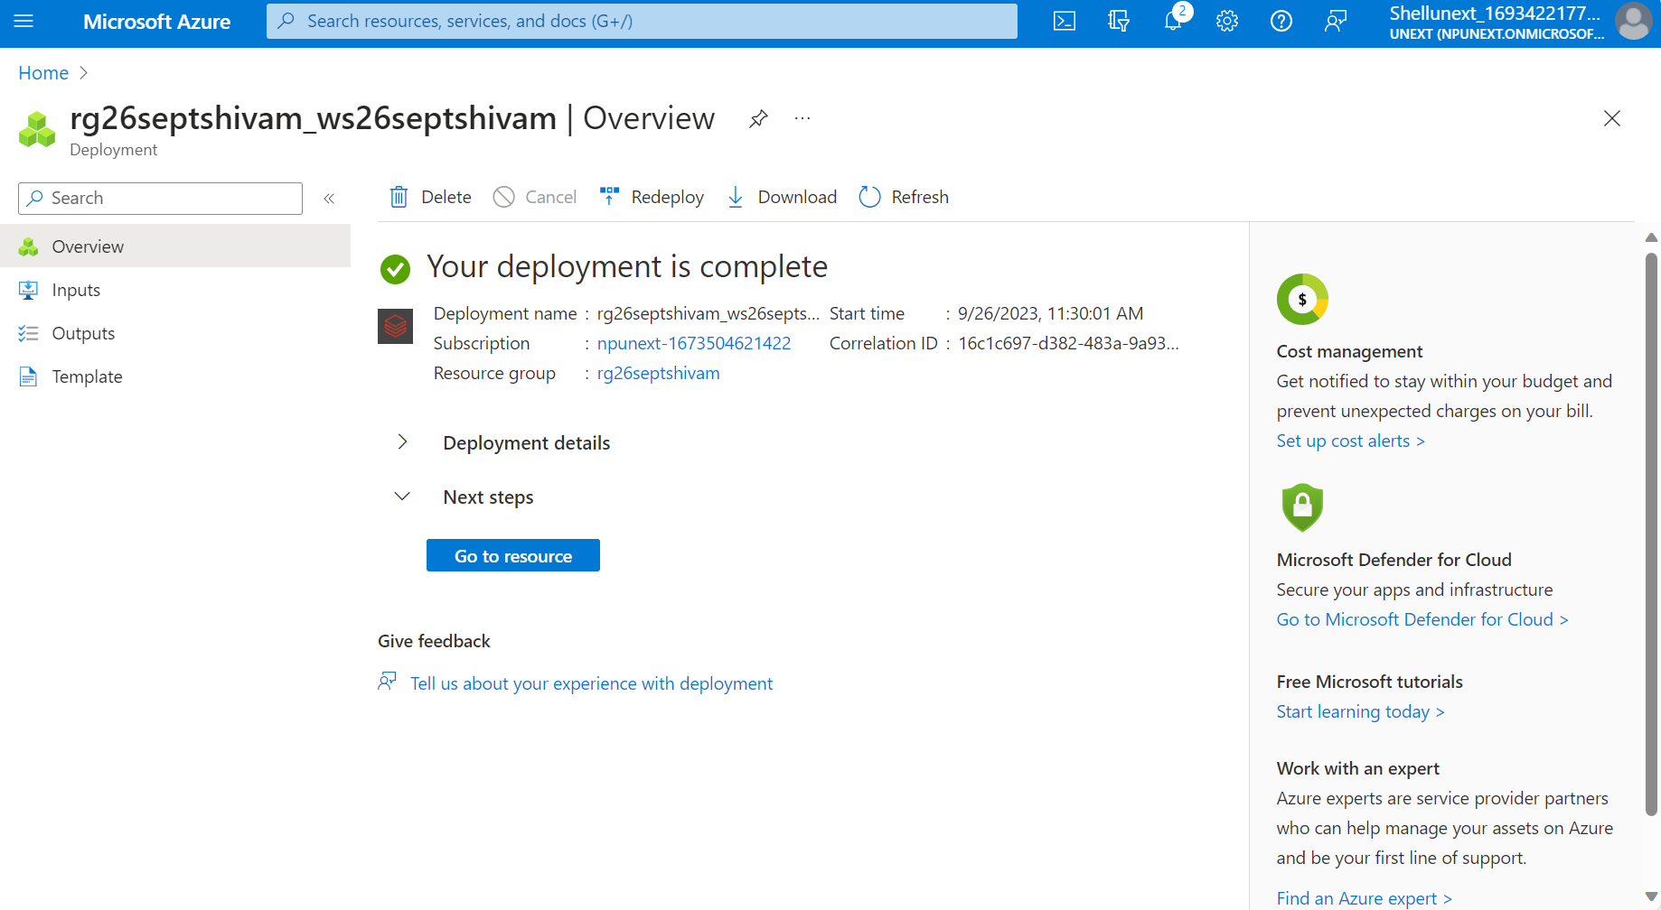
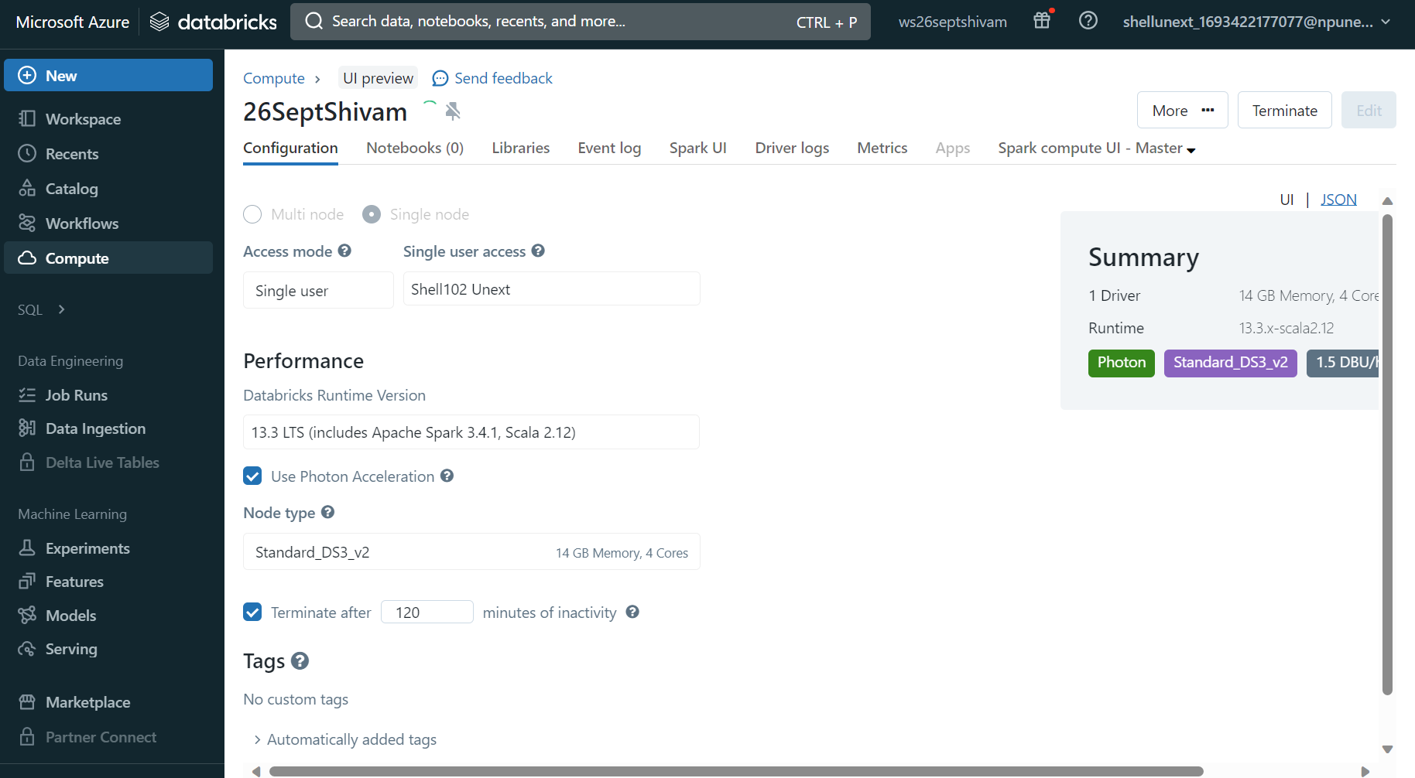

Slide 5
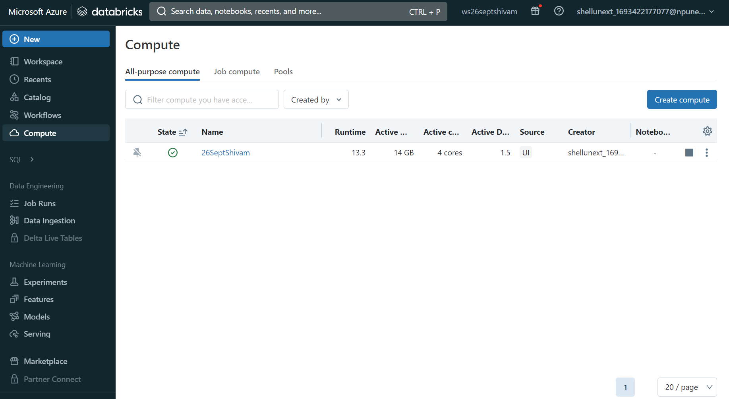
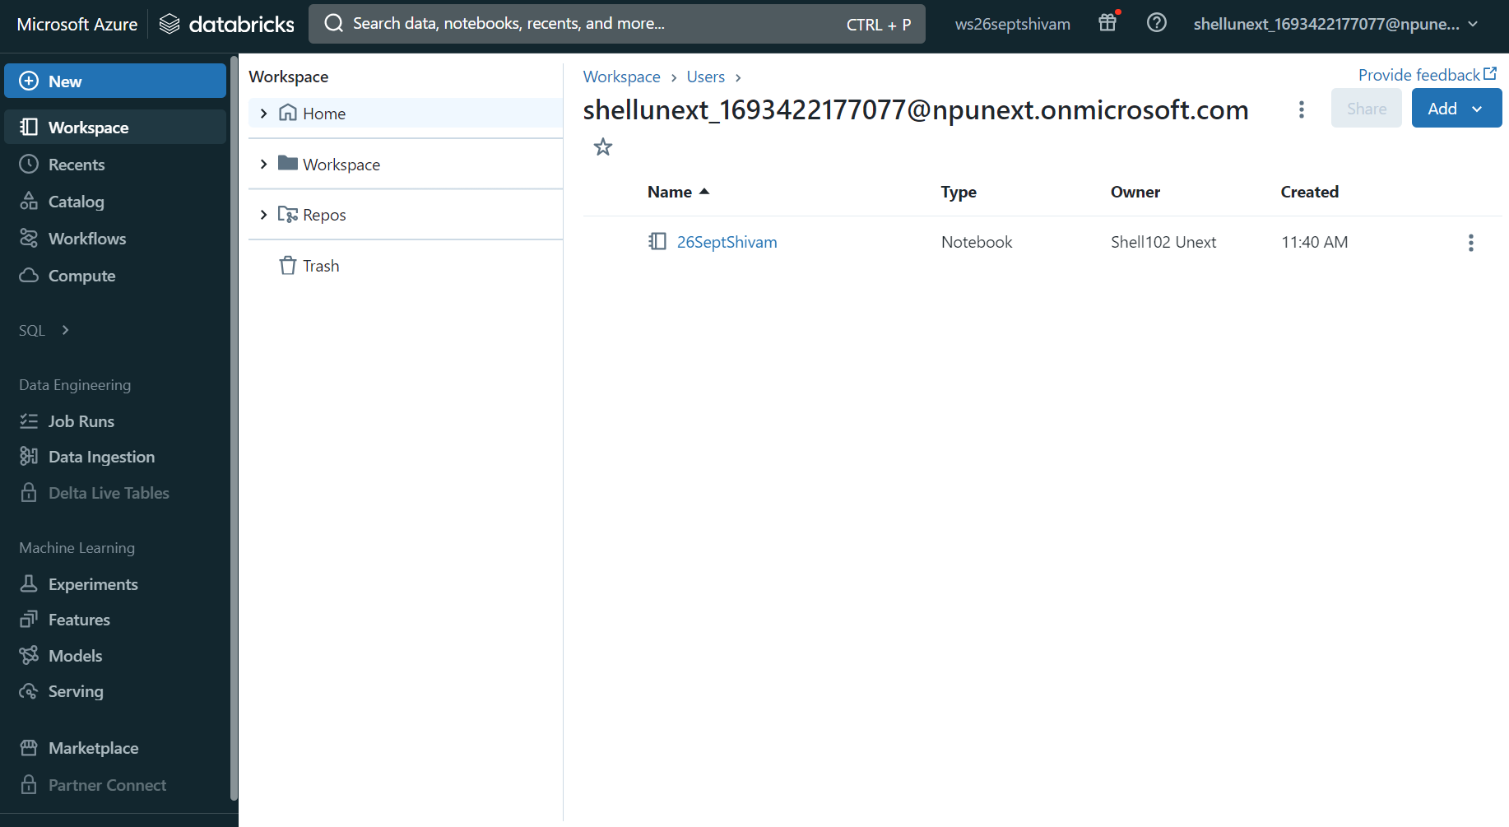
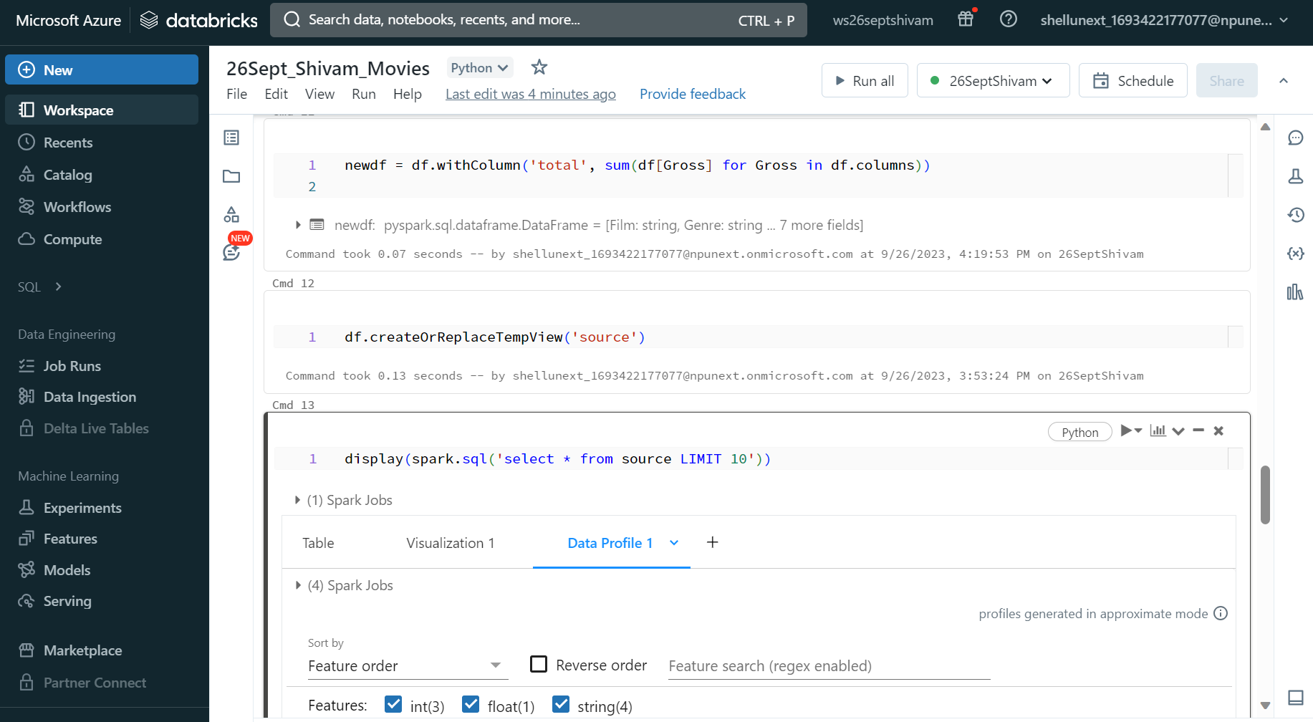
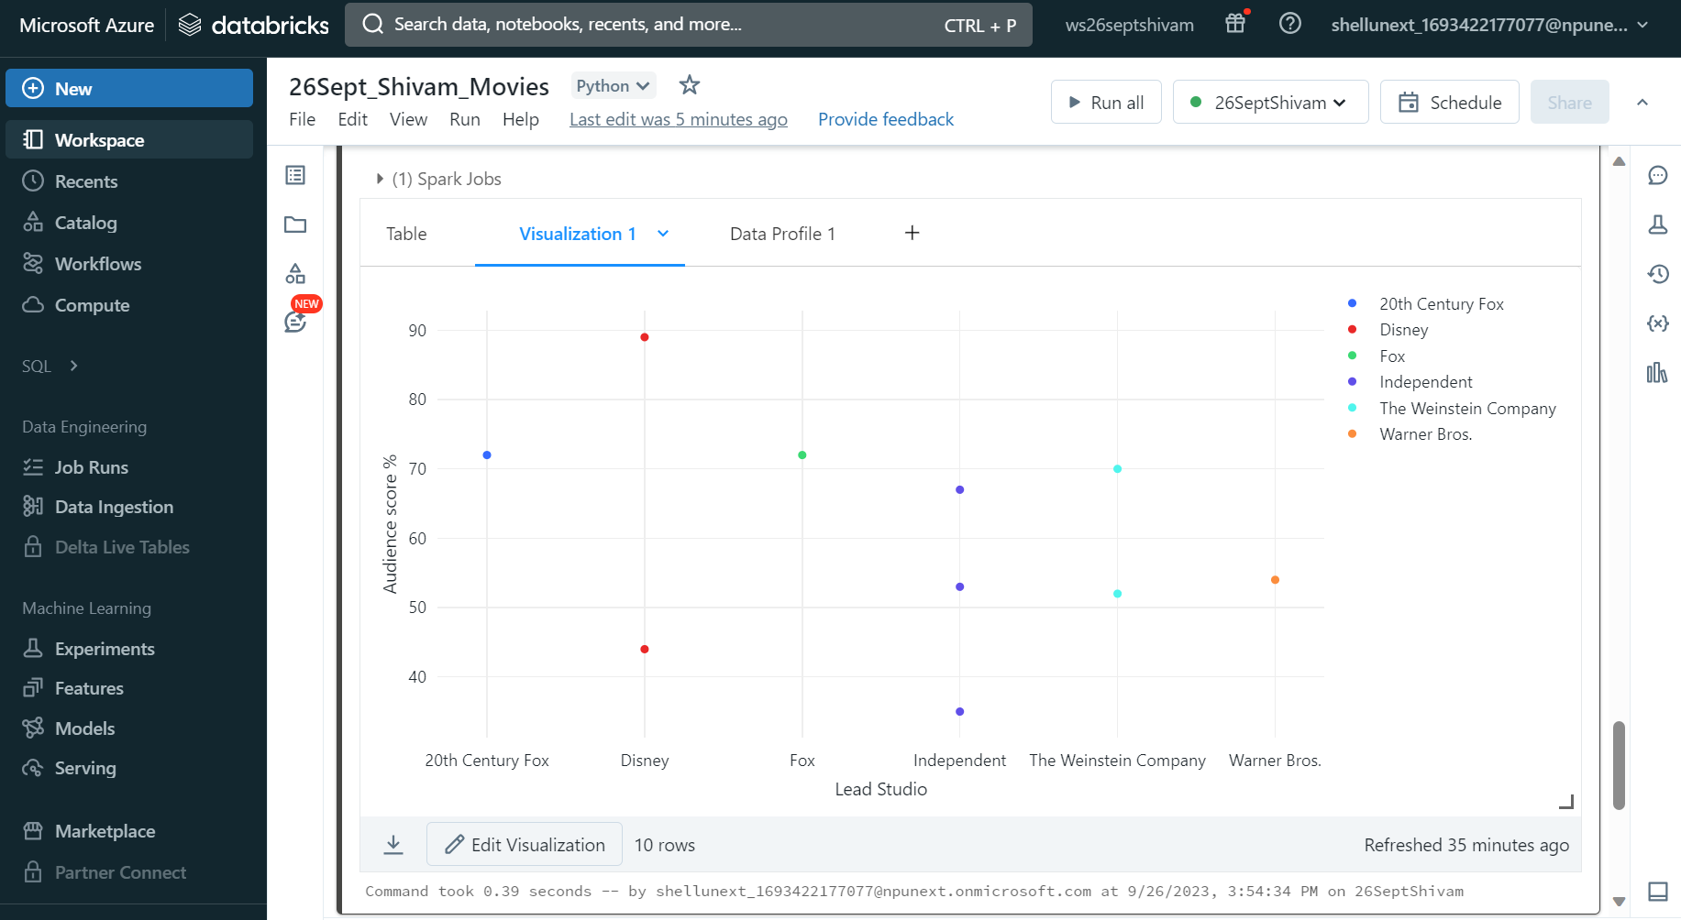

Slide 6
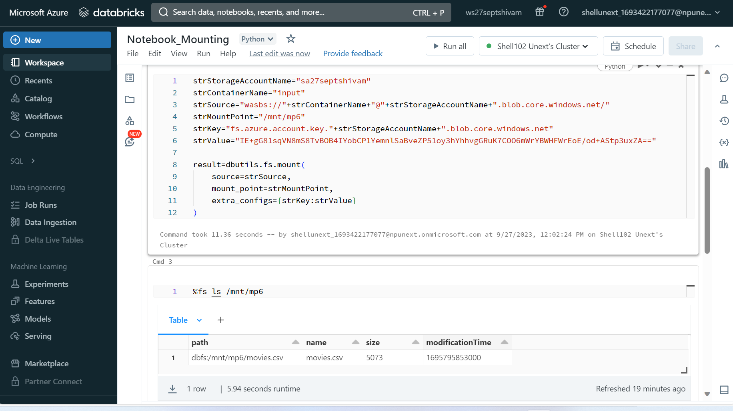
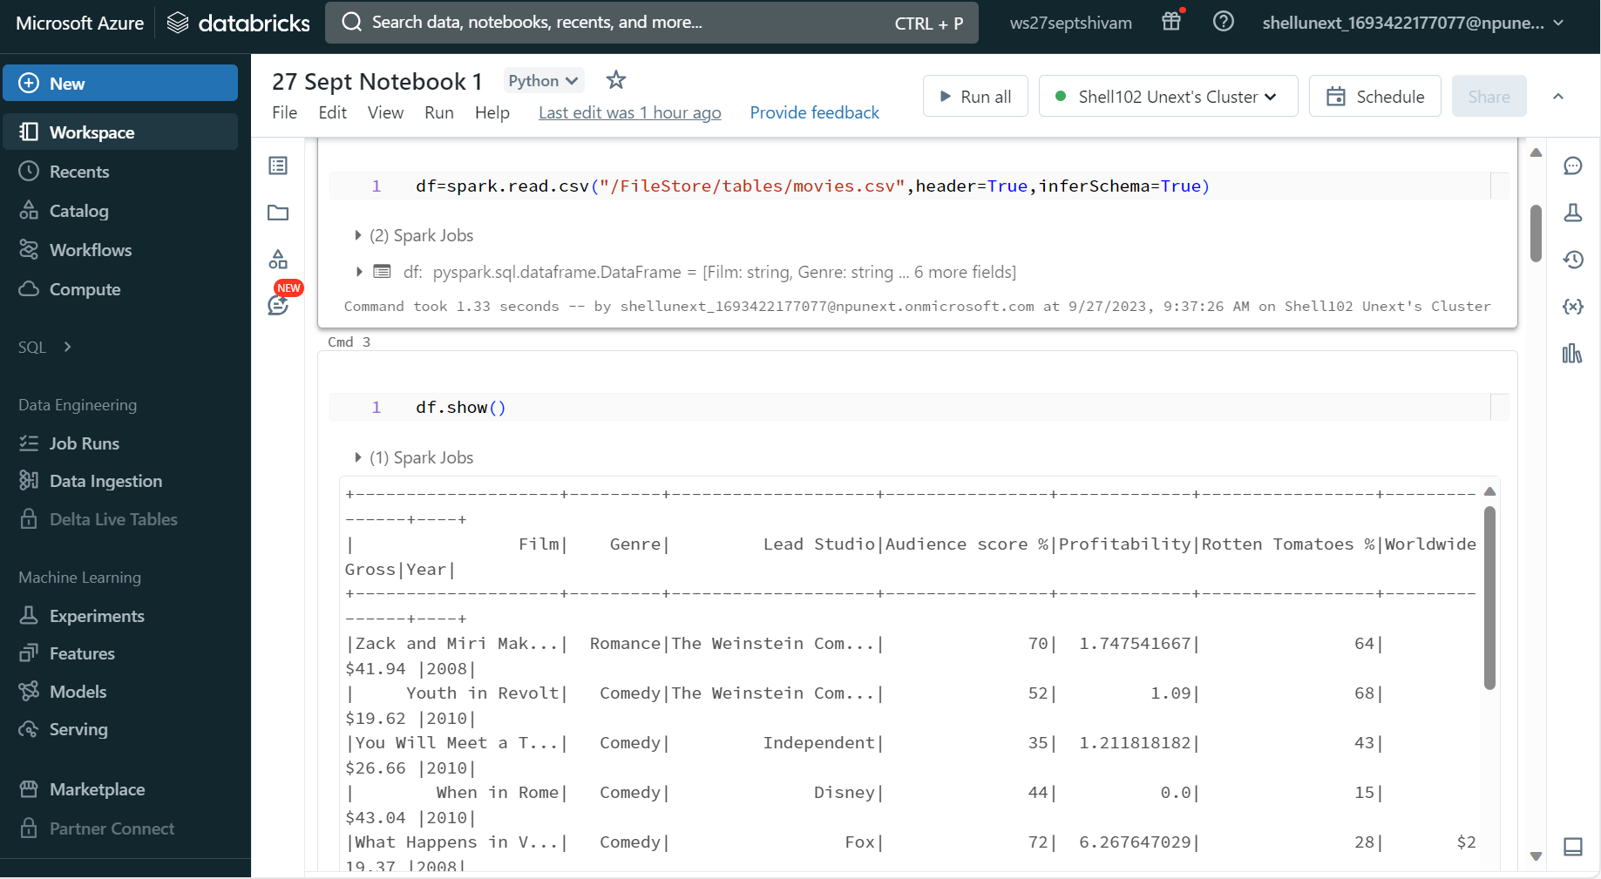
Mounting in Azure Databricks

Slide 7
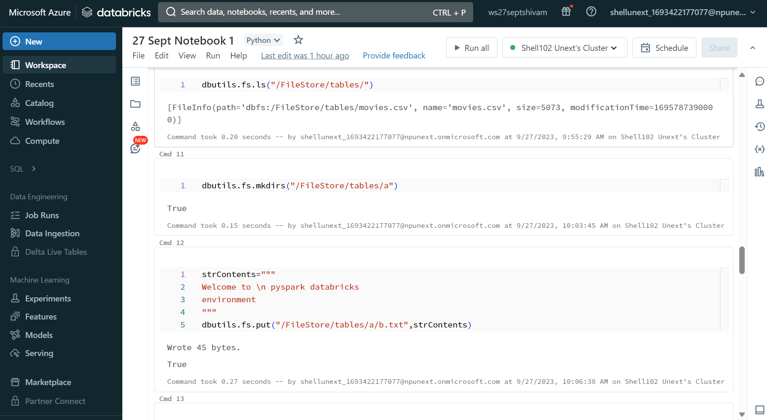
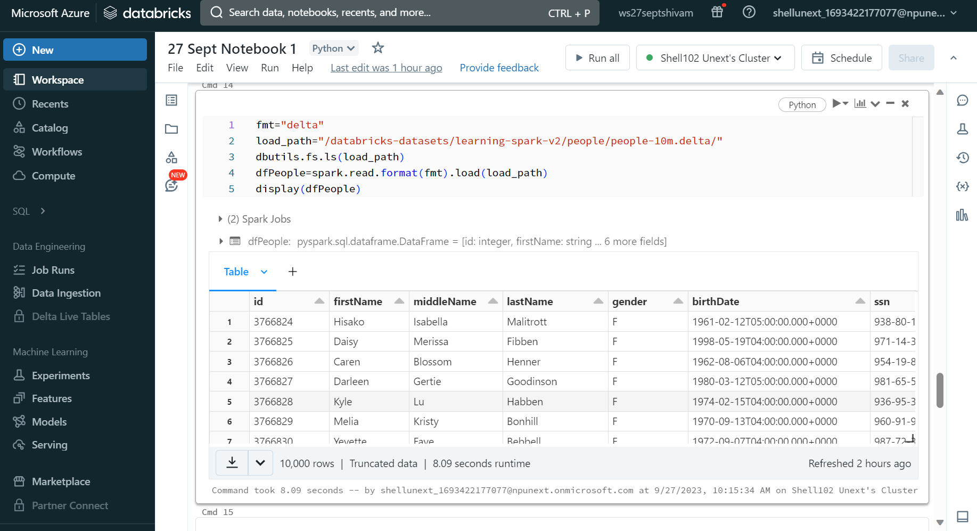
File System Management in Azure Databricks

Slide 8
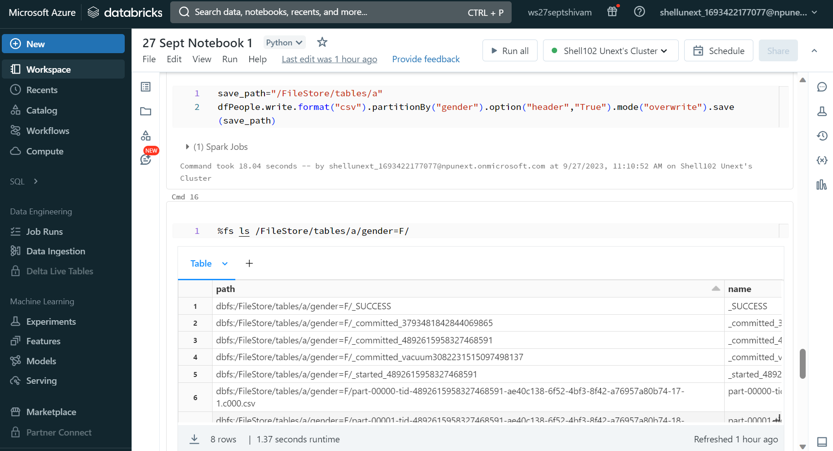
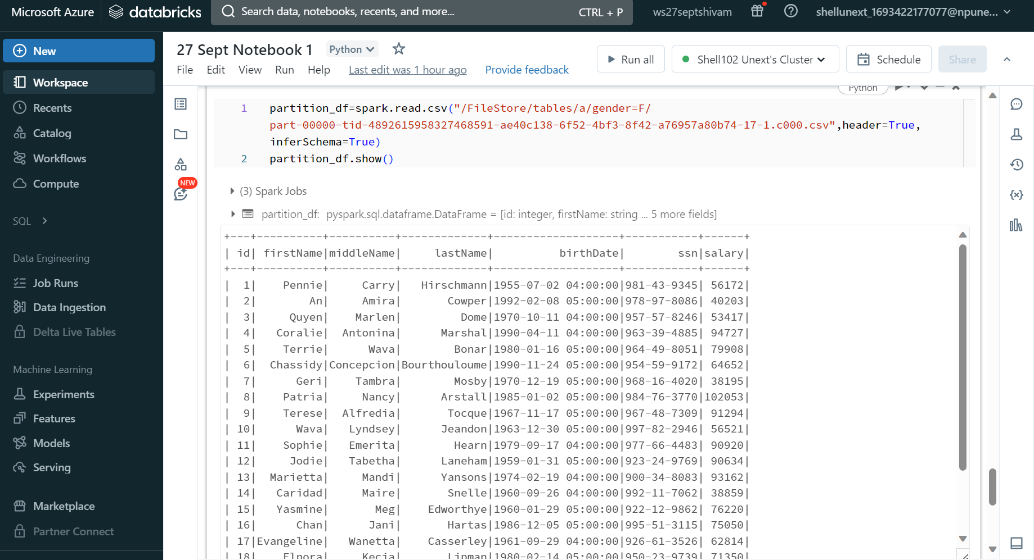

Slide 9
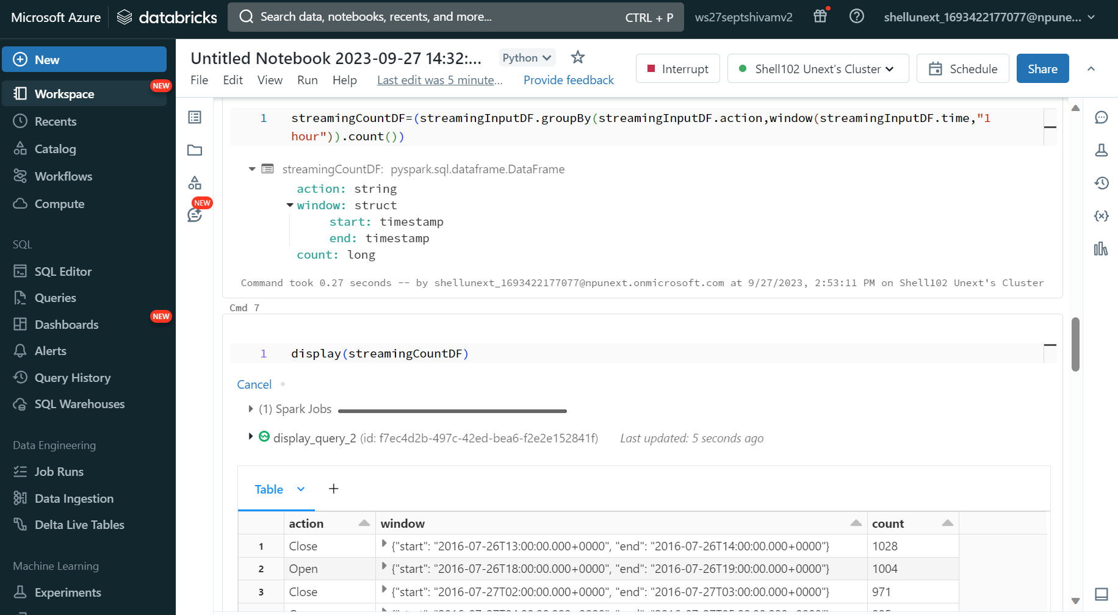
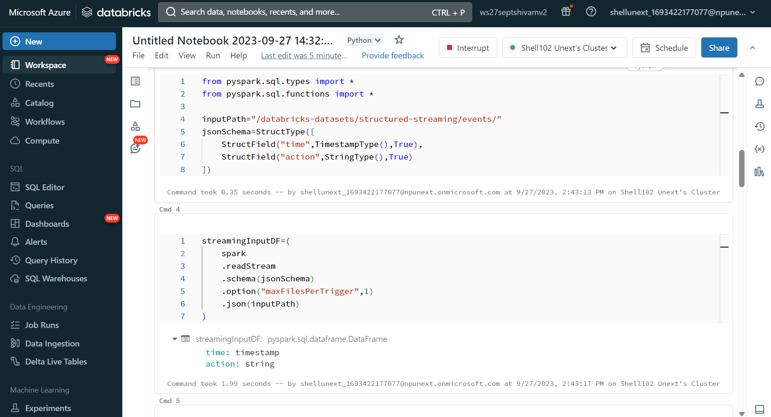
Handling Streaming data in Azure Databricks

Slide 10
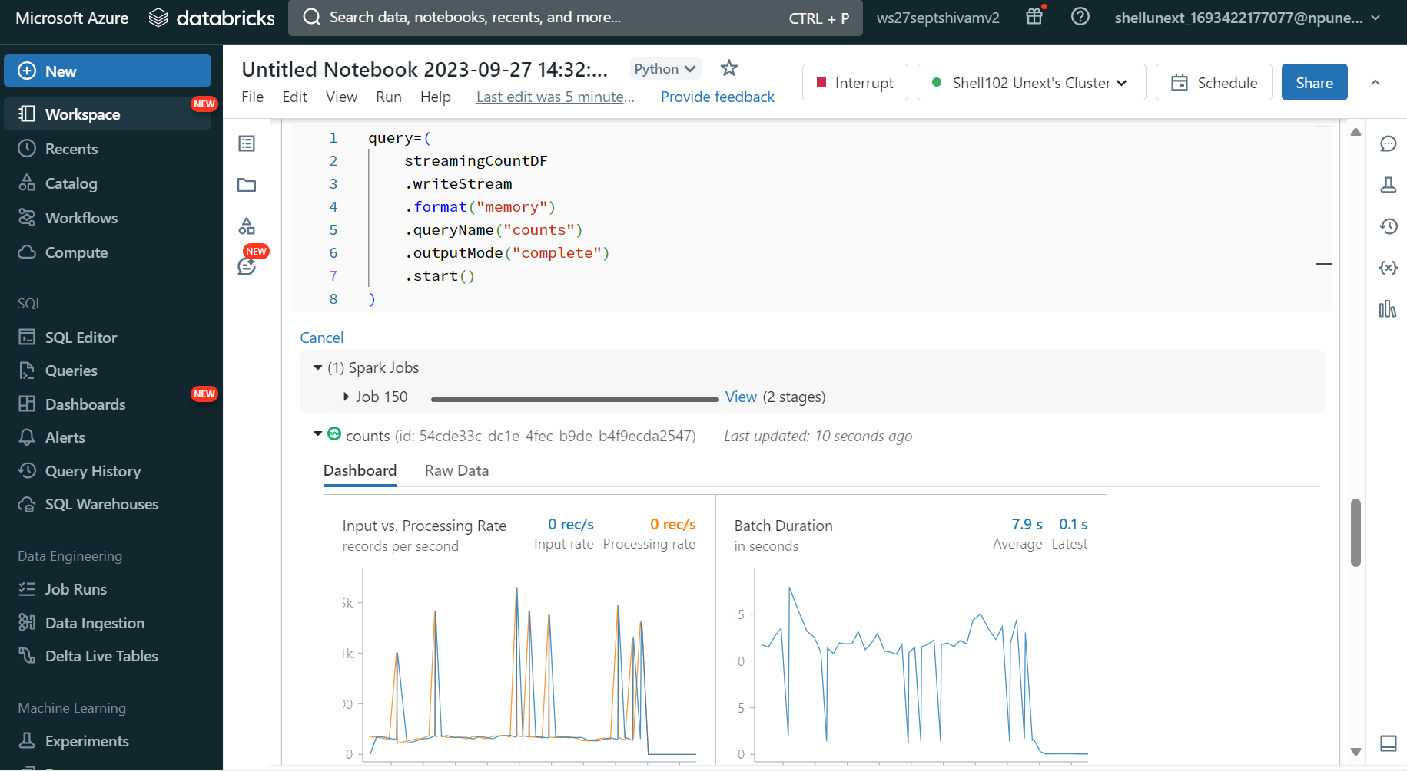

Slide 11
Docker and Kubernetes
Docker is a containerization platform that allows you to package and run applications and their dependencies in isolated units called containers.
Containers ensure that applications run consistently across different environments, from development to production.
Kubernetes (K8s) is an open-source container orchestration platform that automates the deployment, scaling, and management of containerized applications.
Kubernetes manages a cluster of nodes (machines) where containers are deployed, ensuring high availability and fault tolerance.

Slide 12
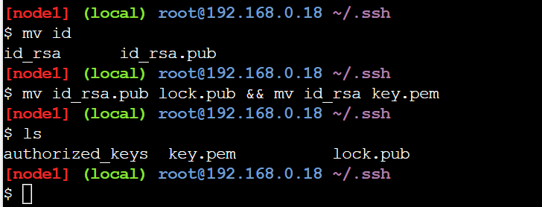
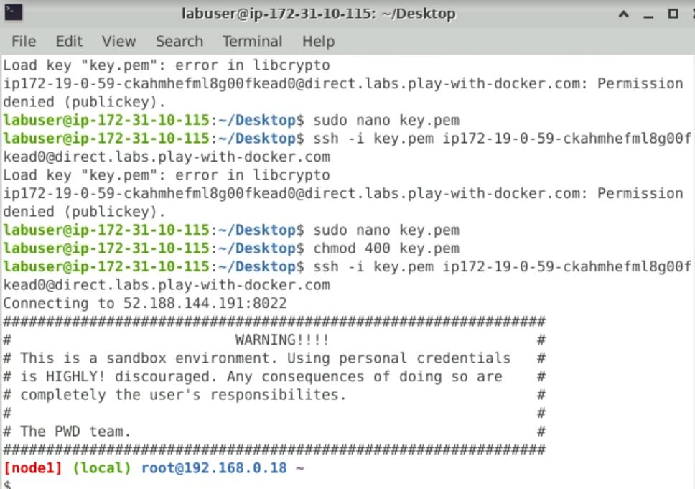

Slide 13
